Slide 1
Secure Data Hiding in image using Steganography
CAPSTONE PROJECT
Presented By: Gattu Jahnavi
Student Name : Gattu Jahnavi
College Name : Geethanjali college of Engineering and technology
Department : BTech-CSE

Slide 2
OUTLINE
Problem Statement
Technology used
Wow factor
End users
Result
Conclusion
Git-hub Link
Future scope

Slide 3
Problem Statement
The program should allow users to select an image and securely embed a secret message using pixel manipulation techniques. It should also provide a decryption mechanism to extract the hidden message upon entering the correct passcode. The system must ensure data integrity, ease of use, and secure access to hidden messages while maintaining the image’s original appearance.

Slide 4
Technology used
Programming Language:
- Python
Libraries & APIs:
OpenCV (cv2) – For image processing (reading, modifying, and saving images)
NumPy – For efficient pixel manipulation
PIL (Pillow) – For handling image formats
Platform Compatibility:
Operating System: Windows, macOS, Linux
Python Version: Python 3.6 or later
Development Environment:
IDE:VS Code, PyCharm, Jupyter Notebook, or any Python-supported editor
Build Tool: No specific build tool required (can use pip for dependency management if needed)
This setup ensures a cross-platform, efficient, and secure command-line-based image steganography application.

Slide 5
Wow factors
Wow Factors of This Project
1️⃣ Python-Based Steganography– Unlike most steganography tools that rely on Flask for UI, this project focuses on efficient command-line execution, making it lightweight and flexible.
2️⃣ Integrated Image Processing – Direct pixel manipulation using OpenCV and NumPy, ensuring efficient and seamless encoding/decoding of secret messages within images.
3️⃣ Lightweight & Dependency-Free – No need for complex GUI frameworks; runs smoothly with essential libraries like OpenCV, NumPy, and PIL.
4️⃣ Cross-Platform Compatibility – Works on Windows, macOS, and Linux without requiring additional graphical dependencies.
5️⃣ Secure & Efficient Encoding – Implements LSB (Least Significant Bit) manipulation for message embedding, ensuring minimal distortion while maintaining data integrity.
This makes your project efficient, secure, and platform-independent while focusing on pure Python-based image processing!

Slide 6
End users
1️⃣ Cybersecurity Professionals & Researchers – Experts studying data hiding techniques, secure communication, and digital forensics.
2️⃣ Journalists & Whistleblowers – Individuals who need to discreetly transmit sensitive information without detection.
3️⃣ Students & Educators – Learners and instructors in cybersecurity, cryptography, and digital forensics exploring practical applications of steganography.
4️⃣ Law Enforcement & Forensic Analysts – Investigators analyzing hidden messages within digital images to uncover cybercrime evidence.
5️⃣ Privacy Advocates & Everyday Users – Individuals seeking secure, low-profile communication methods without relying on conventional encryption.
6️⃣ Military & Intelligence Agencies – Personnel requiring covert communication for secure information exchange in high-risk scenarios.

Slide 7
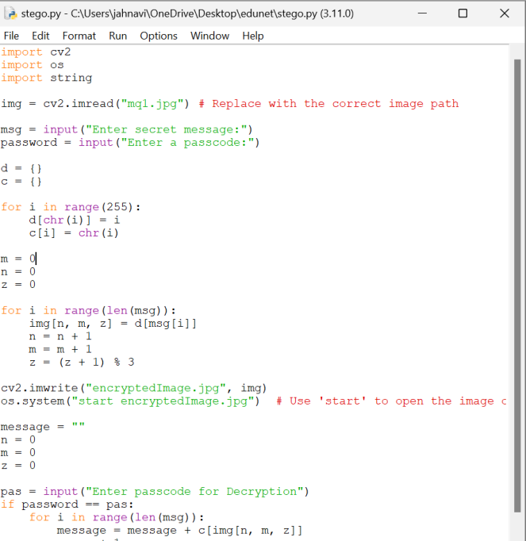
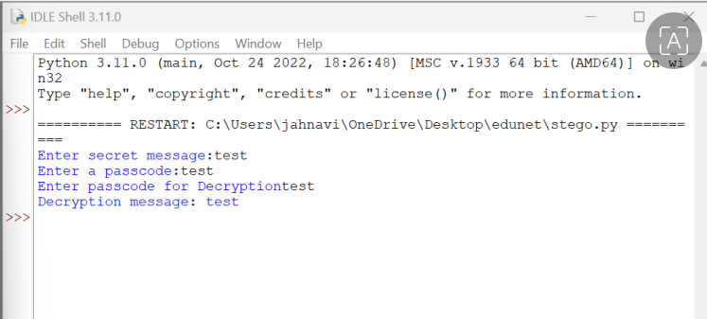
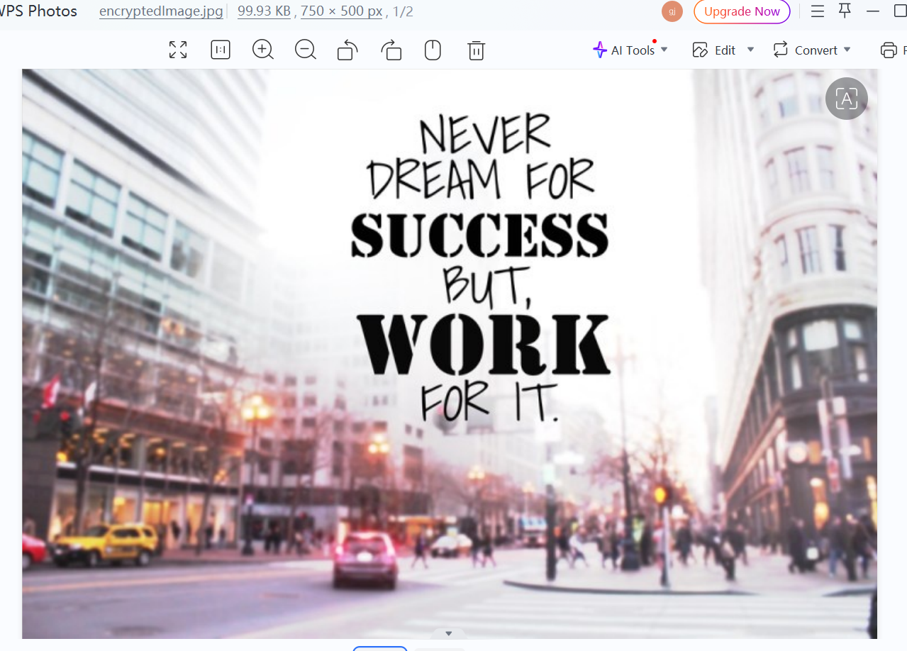
Results

Slide 8
Conclusion
This project demonstrates Python-based Image Steganography for securely embedding and retrieving hidden messages within images. Using pixel manipulation techniques with OpenCV, it provides an efficient and lightweight solution for covert communication. Unlike traditional encryption methods, this approach ensures minimal detectability while maintaining image integrity. Designed for cybersecurity professionals, forensic experts, journalists, and privacy-conscious users, this tool offers a secure, cross-platform, and command-line-driven method for confidential data exchange. By integrating image processing and cryptographic principles, this project highlights the practical applications of steganography in real-world security scenarios.

Slide 9
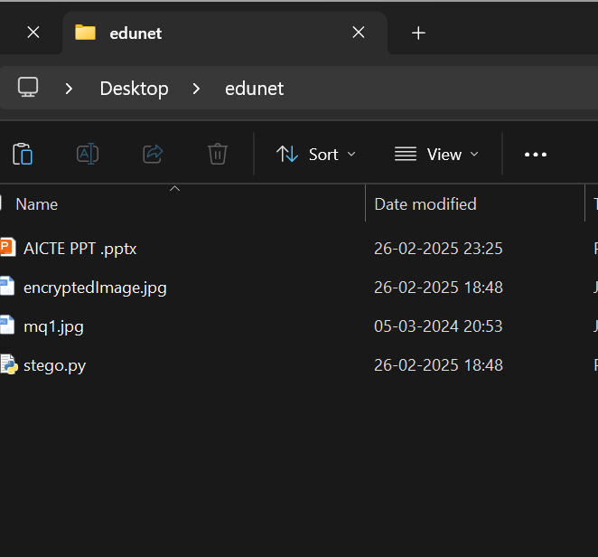
GitHub Link
https://github.com/gattujahnavi/Stenography-Application-project.git

Slide 10
Future scope(optional)
Enhanced Encryption Techniques – Implementing advanced cryptographic algorithms like AES or RSA to further strengthen the security of hidden messages within images.
Multi-Format Support – Expanding compatibility to support additional image formats like PNG, BMP, and TIFF for greater flexibility in data hiding.
Steganography in Video & Audio – Extending the project to hide messages not just in images but also in video and audio files, providing a more discreet medium for secure communication.
Steganography on Mobile Platforms – Developing a mobile-friendly version of the tool for Android and iOS, enabling users to securely embed and extract messages on the go.
Watermarking for Security & Copyright Protection – Integrating digital watermarking techniques to protect sensitive content and verify authenticity.
Real-Time Secure Messaging – Enabling live encryption and decryption of messages exchanged via real-time communication platforms, such as video calls or streaming services.

Slide 11
THANK YOU

